Slide 1
Origami Zombie Game
Advanced AI project Group 2

Slide 2
Group member
Mbali Qalinge (Group Leader)
Marshall Mulanga Nekhubvi
Muhammad Zukhraf Zubair
Mbhekeni Alfred Ngomane
Rhulani George Hlungwani

Slide 3
Game specification
Multiagent game environment where multiple agents will be origamis and the other agents will be the Zombies.
For the origami’s initial state, it is moving around the world and when it detects a Zombie in its radius then it will attack. The same applies to the Zombies and how attack.
To mimic the learning capabilities of the immune system, the origamis are able to detect the Zombies using the NSA.
There’s also the clonal selection algorithm for cloning the zombies.
Origamis are built using multiple triangles and their shapes can be changed.

Slide 4
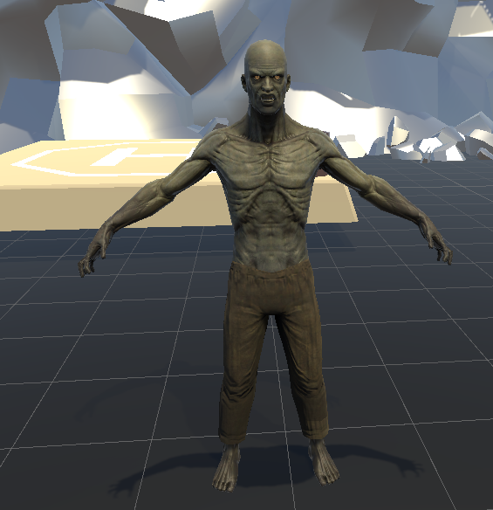
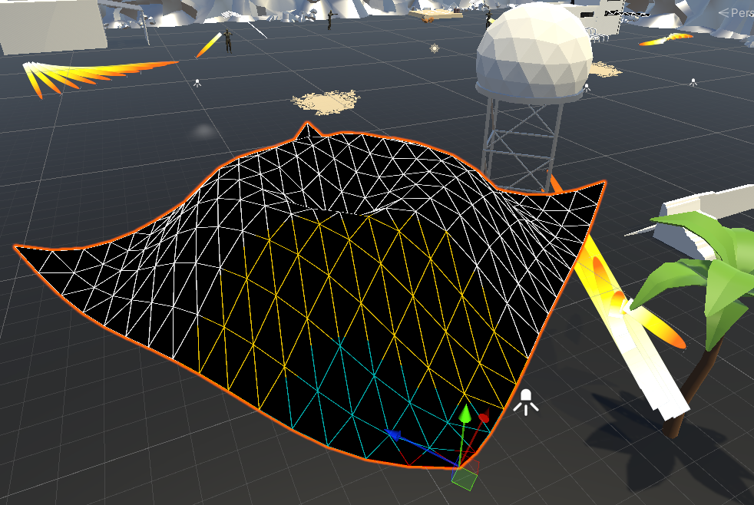
Representation of Agents

Slide 5
Game mOdules
GUI – Game interface in Unity.
Multiagent module – Handles the multiple origami robots and zombies to be created.
AIS Algorithms – This handles all the immunity-based algorithms to be implemented in the game.
Origami robots –The creation of Origami shapes into the game.

Slide 6
Marshall MULANGA Nekhubvi (Gui and agents)
The game user interface is built using different models and material.
The world consists of the ground that is walkable by agents and also the Obstacles that the agents cannot walk on.
The world make use of NavMesh surface components to allow the agents to move without the user trying to controlling it.
The Zombie character are from the assetstore.

Slide 7
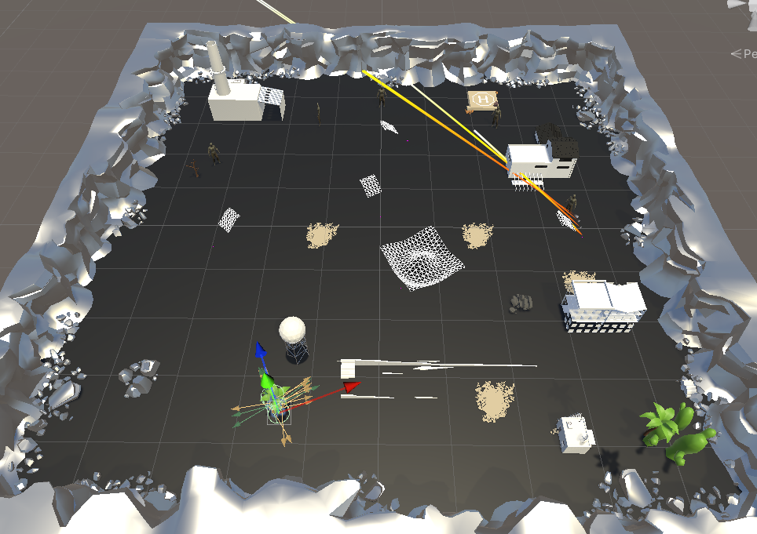

Slide 8
Muhammad Zukhraf Zubair (Origami Implementation and Movement)
The Origami shape is created by adding number of different triangles.
To give the different shape to the origami we added shape changer.
Then we gave the movement function to the origami to move around in the world.

Slide 9
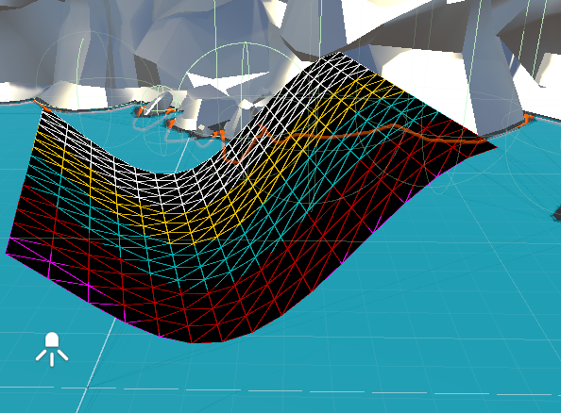
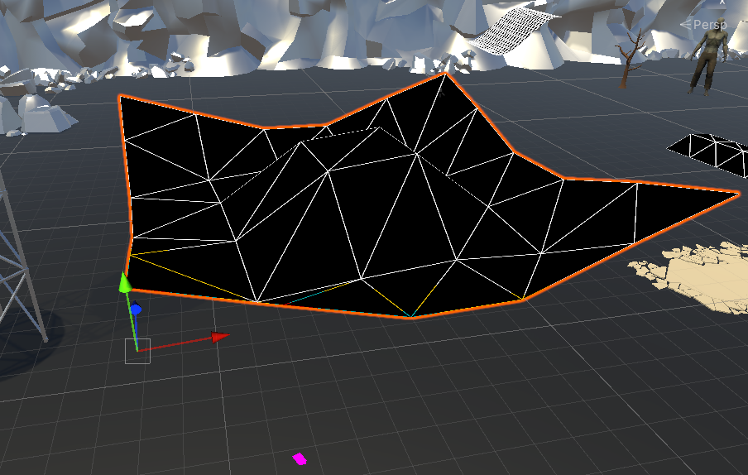
Different shapes Of Origamis

Slide 10
Mbali Qalinge (Negative selection algorithm and shooting)
Negative Selection Algorithm for the origami's zombie detection and shooting strategy.
Representation: Each origami robot and zombie have a string representation. The origami representation has a certain pattern to identify it as part of the self-space.
Detectors also have string representation with a Hemming Distance matching rule.
NSA Input: String list for the origamis (self-space)
Step 1: Valid detector generation
Step 2: Detect a zombie using its representation and match it to the detectors generated in step 1.
When origami detects a zombie using the NSA, it shoots at it

Slide 11
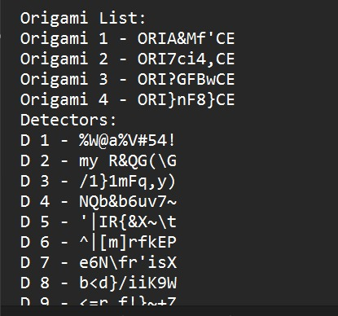
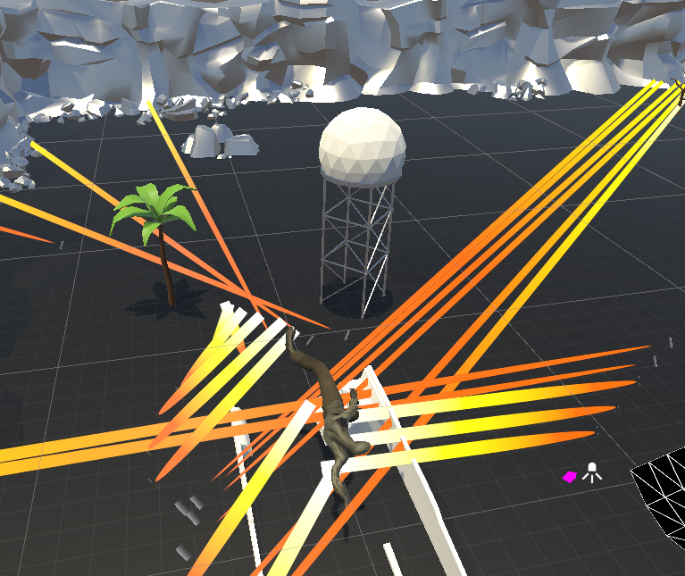
NSA game representation

Slide 12
Mbhekeni Alfred Ngomane (Clonal selection)
Clonal selection is a type of immune algorithm that has been inspired by how B cells respond to antigens.
The type of representation that we used for our cells is string representation.
Its Advantages are that it can maintain a specific memory set, can select and clone antibodies that receive the most stimulation, removal of the rest, hypermutation of the ones that are active and Creation and maintenance of a variety of antibodies.
We chose clonal selection on our system because it can help evolve our game, and keep it going.
The way it does this is by cloning all the zombies in the world with the highest affinity and replacing the rest with lowest affinity by randomly generated new antibodies.

Slide 13
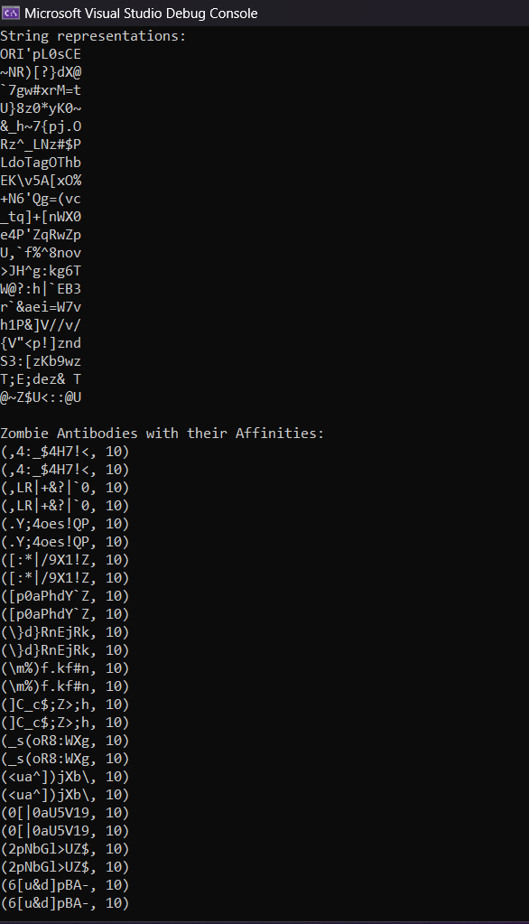
Clonal selection game representation

Slide 14
Rhulani George Hlungwani (health)
Worked on enemy health
Origami health
Origami replenish energy on killing enemy
Health bars on both origami and zombies

Slide 15
References
Gupta, K.D. and Dasgupta, D., 2021. Negative selection algorithm research and applications in the last decade: a review. IEEE Transactions on Artificial Intelligence.
Amiripalli, S.S., Jitendra, M.S., Talari, S., Akkireddi, S. and Kumar, D.S., 2020. Design and Implement an Artificial Intelligence based Zombie's Application using Unity3D.
Zikky, M., 2016. Review of A*(A star) navigation mesh pathfinding as the alternative of artificial intelligent for ghosts agent on the Pacman game. EMITTER International journal of engineering technology, 4(1), pp.141-149.
Guarnizo, J.G. and Niño, L.F., 2019, July. Clonal Selection Algorithm Applied to Object Recognition in Mobile Robots. In MLDM (1) (pp. 49-62).
Shim, Y.A., Park, K., Lee, S., Son, J., Woo, T. and Lee, G., 2020, October. FS-Pad: Video Game Interactions Using Force Feedback Gamepad. In Proceedings of the 33rd Annual ACM Symposium on User Interface Software and Technology (pp. 938-950).

Slide 16
Project demostration

